Slide 1
SS8H3b
Georgia’s
History:
The Revolutionary War
© 2014 Brain Wrinkles

Slide 2
Loyalties
The colonists were split by their beliefs on American independence.
Many older colonists had been born in England and were loyal to the mother country.
These people were called Loyalists or Tories.
Settlers who supported independence were called Patriots.
© 2014 Brain Wrinkles

Slide 3
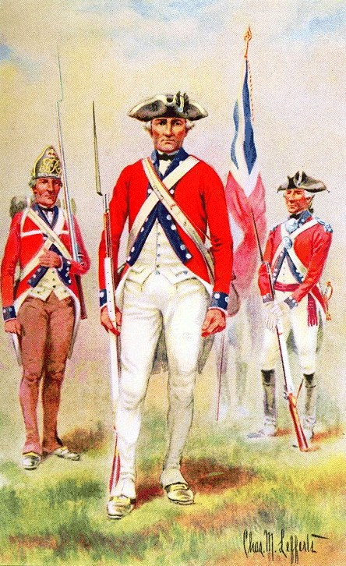
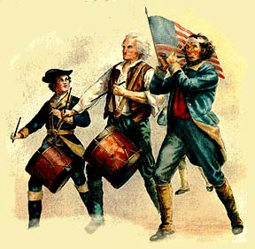
© 2014 Brain Wrinkles

Slide 4
British Wins
In 1778, British troops began moving inland from the Georgia coast.
The first battle took place in Savannah when the British forces snuck through surrounding swamps and attacked the Patriot garrison.
Savannah fell to the British on December 29, 1778, and Augusta came under British control a month later.
© 2014 Brain Wrinkles

Slide 5
Kettle Creek
The Battle of Kettle Creek broke the British stronghold in Georgia in 1779.
A group of 700 British troops camped along Kettle Creek.
A Patriot militia led by Elijah Clarke and John Dooly surprise attacked the soldiers.
This led to a Patriot victory and boosted the morale of Georgia’s Patriots.
© 2014 Brain Wrinkles

Slide 6
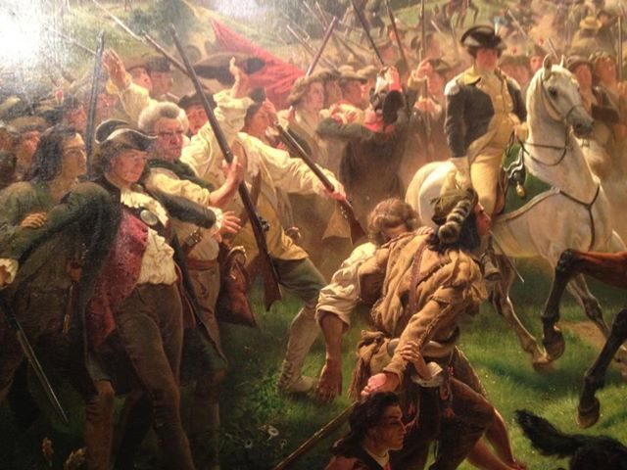
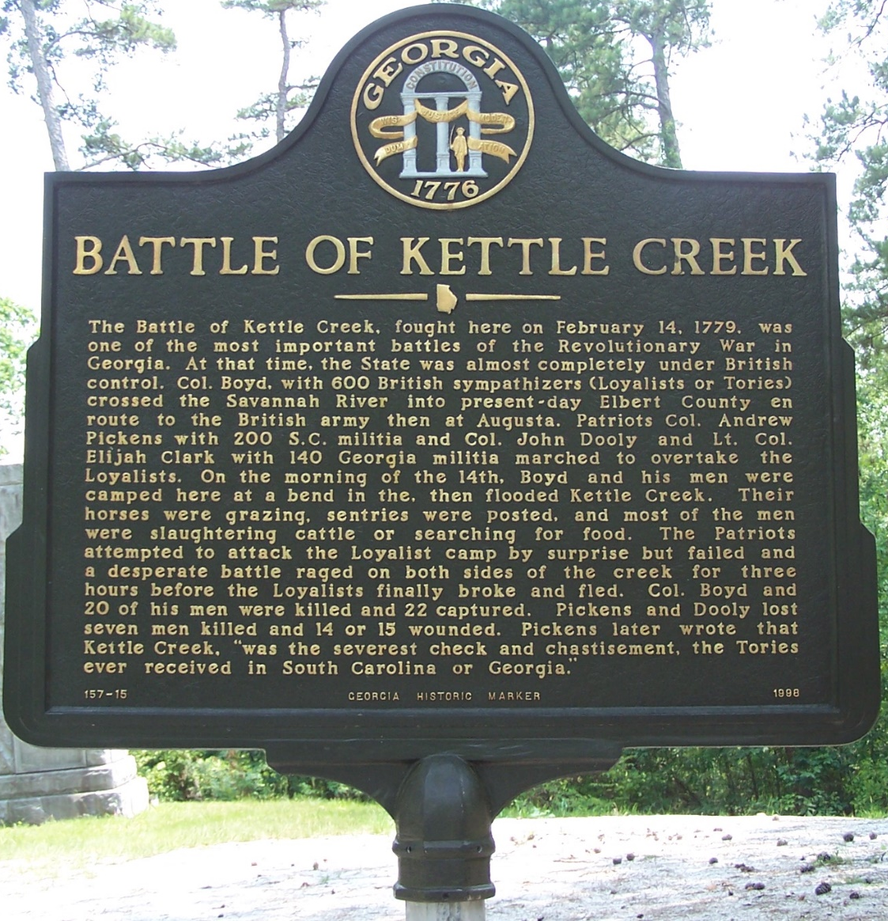
© 2014 Brain Wrinkles

Slide 7
Elijah Clarke
Lieutenant Colonel Elijah Clarke was a poor farmer from North Carolina who joined Georgia’s militia when fighting broke out.
After the victory at Kettle Creek, Clarke continued to lead frontier men in guerilla war tactics across Georgia and the Carolinas.
In 1781, he helped regain the control of Augusta.
© 2014 Brain Wrinkles

Slide 8
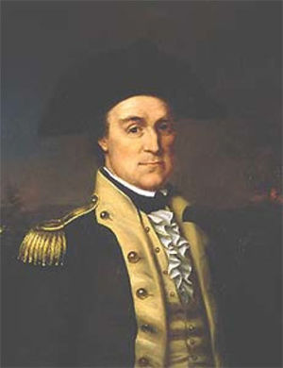
Col. Elijah Clarke –
Clarke County was named in his honor.
© 2014 Brain Wrinkles

Slide 9
Austin Dabney
Austin Dabney was a Georgia slave who fought alongside the Patriots during the Battle of Kettle Creek.
Dabney served in place of his master, and is thought to be the only African American who fought in the battle.
Because of his bravery in the battle, Georgia’s General Assembly paid for his freedom from his former master and gave him 50 acres of land.
© 2014 Brain Wrinkles

Slide 10
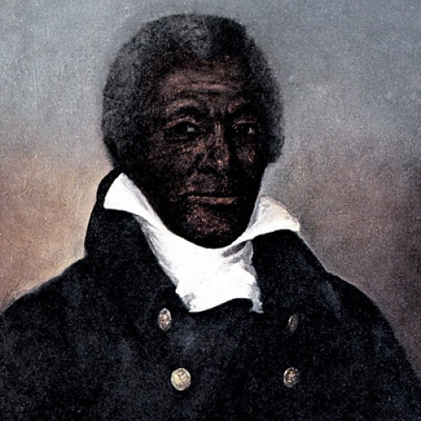
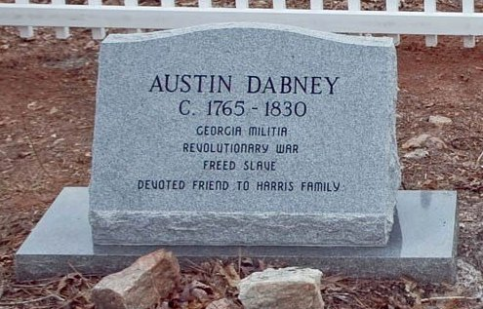
© 2014 Brain Wrinkles

Slide 11
Siege of Savannah
In 1779, the second bloodiest battle of the American Revolution occurred in Savannah.
A joint force of French and patriot troops attacked Savannah and attempted to regain control of the city.
The battle itself, known as the Siege of Savannah, lasted only 90 minutes, but hundreds of men were killed.
This attack was a dismal failure and Savannah remained under British control until 1782.
© 2014 Brain Wrinkles

Slide 12
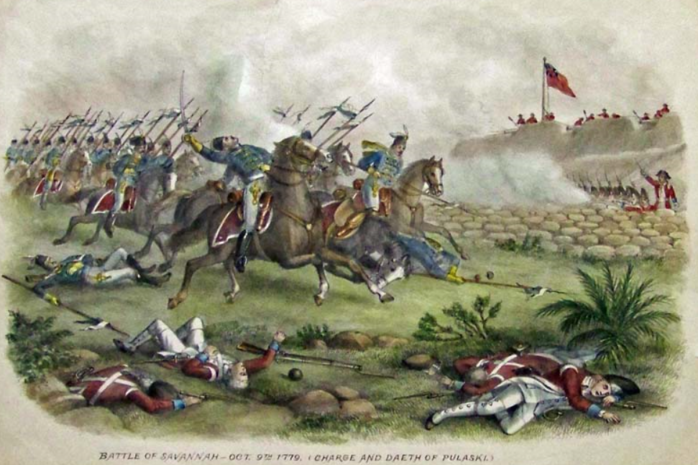
© 2014 Brain Wrinkles

Slide 13
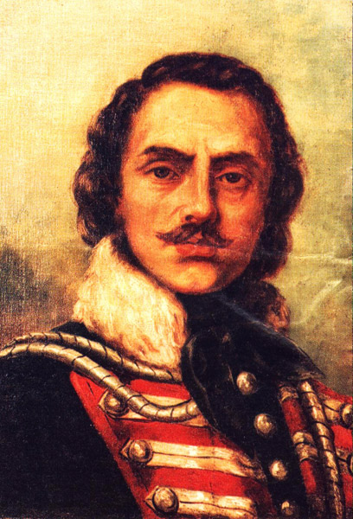
Count Casimir Pulaski, a famous Polish soldier who had come to America to fight for freedom, died in a cavalry charge during the battle. Pulaski County was named for him.
© 2014 Brain Wrinkles

Slide 14
Patriot Wins
After the defeat in Savannah, Georgia saw many more battles between Patriots and Loyalists.
The American Revolution finally began to swing in favor of the Patriots.
In 1781, the Patriots recaptured Augusta, and the British withdrew from Savannah in 1782.
The Treaty of Paris 1783 granted America independence from England.
© 2014 Brain Wrinkles

Slide 15
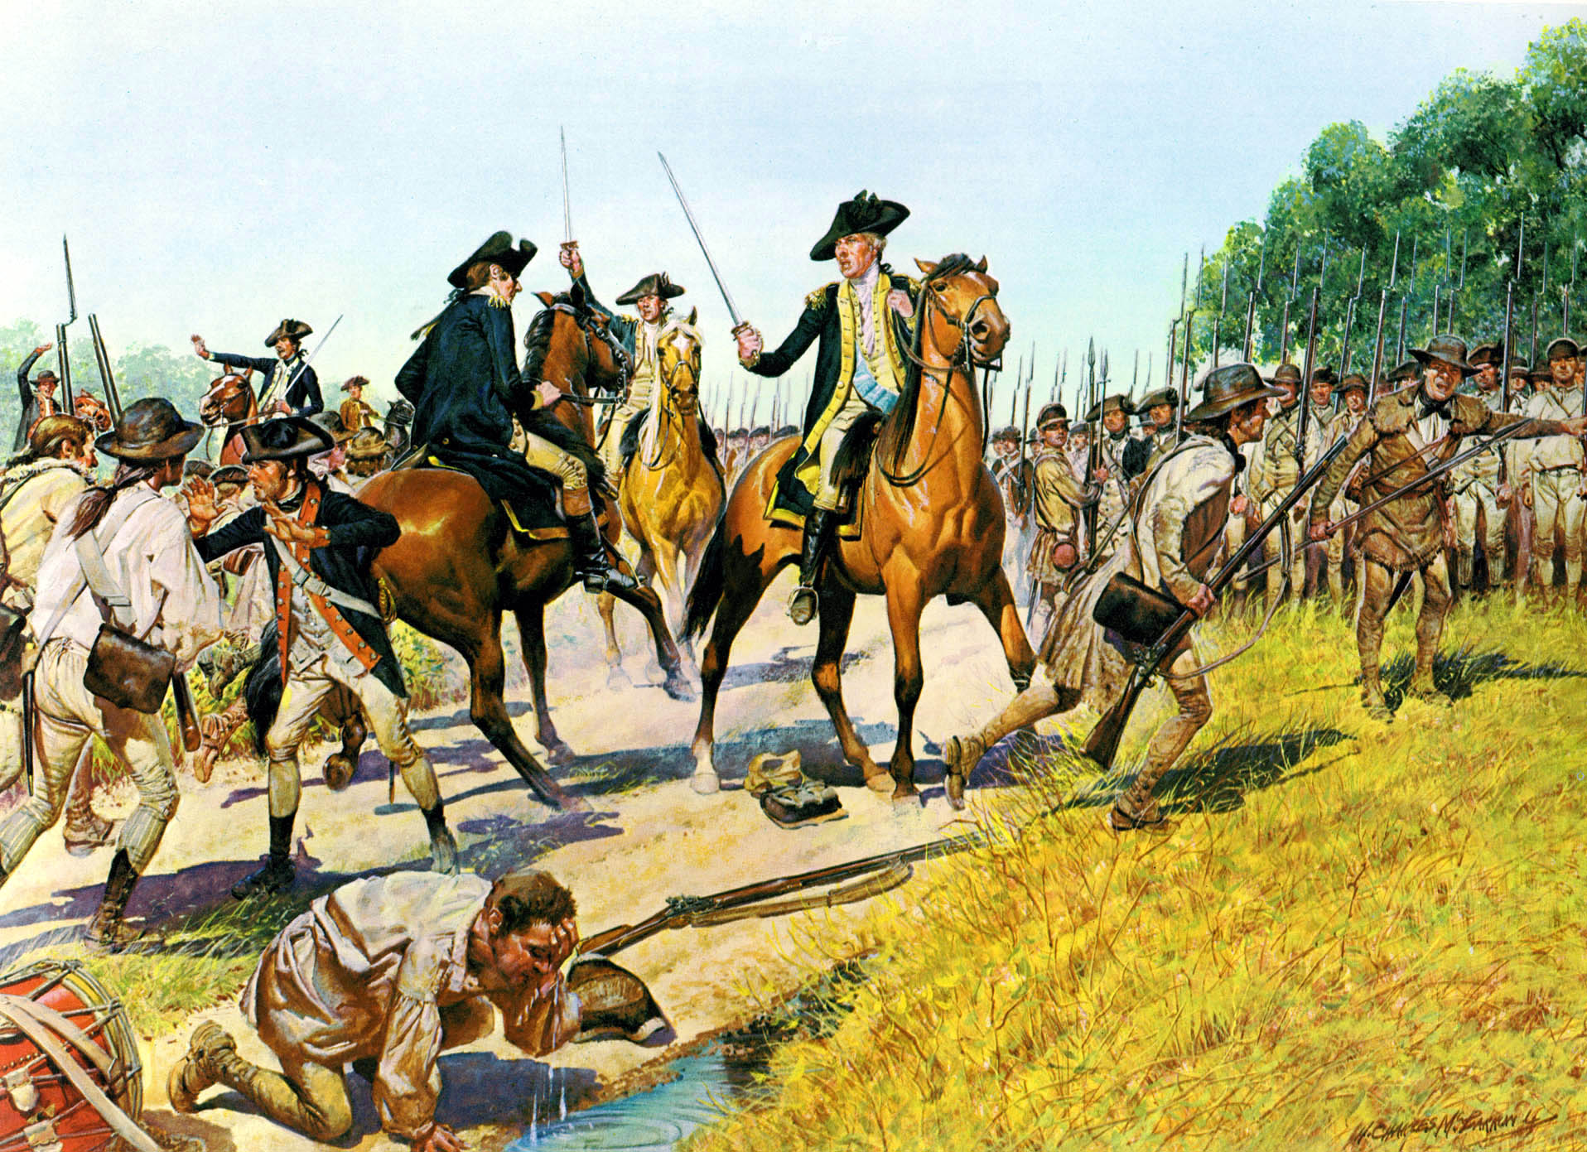
© 2014 Brain Wrinkles

Slide 16
Nancy Hart
Along with Elijah Clarke and Austin Dabney, many other Georgia heroes emerged during the American Revolution.
Nancy Hart’s farm was invaded by six British soldiers and demanded that she feed them.
The soldiers realized that she hid their weapons and charged at her.
© 2014 Brain Wrinkles

Slide 17
Nancy Hart
Hart killed one soldier, wounded another, and held the rest at gunpoint until her husband returned home.
It was rumored that Hart acted as a spy for the Patriots and entered the British camp at Kettle Creek dressed as a man.
© 2014 Brain Wrinkles

Slide 18
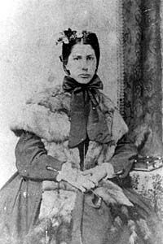
Nancy Morgan Hart – Hart County was named in her honor in 1853.
© 2014 Brain Wrinkles

Slide 19
Button Gwinnett
Button Gwinnett was born in England in 1735 and arrived in Georgia in 1765.
He was a merchant, plantation owner, and an important figure in Georgia’s politics.
During the Revolutionary War period, Gwinnett was an influential member of the Whig Party and became the leader of the radical St. John’s Parish patriot group.
© 2014 Brain Wrinkles

Slide 20
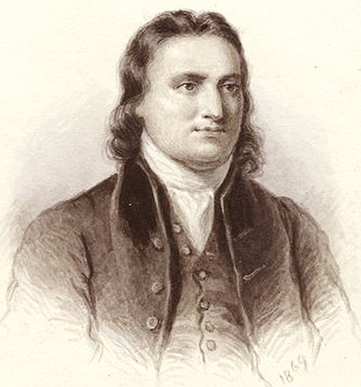
Button Gwinnett –
Gwinnett County was named in his honor.
© 2014 Brain Wrinkles

Slide 21
Button Gwinnett
In 1776, Gwinnett became a delegate to the Continental Congress where he signed the Declaration of Independence.
In 1776, Gwinnett became embedded in a political rivalry with Lachlan McIntosh and challenged him to a deadly duel.
Both men were shot and Gwinnett passed away on May 19, 1777.
© 2014 Brain Wrinkles

Slide 22
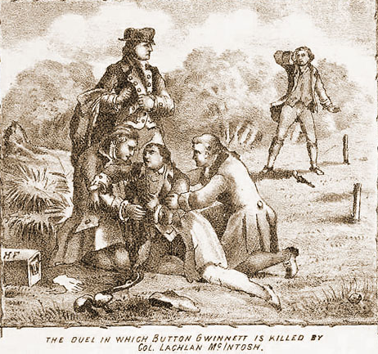
© 2014 Brain Wrinkles

Slide 23
Lyman Hall
Lyman Hall was a minister and a doctor from Connecticut who practiced medicine in Georgia and South Carolina.
He moved to Georgia in 1760 and joined Button Gwinnett in leadership of the St. John’s Parish.
Hall was a member of the Georgia delegation to the Second Continental Congress and signed the Declaration of Independence.
© 2014 Brain Wrinkles

Slide 24
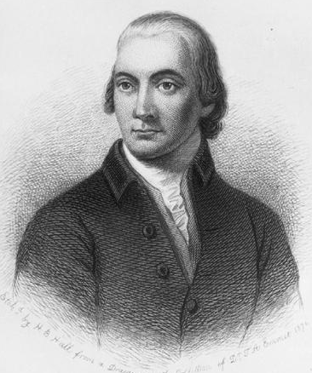
Lyman Hall –
Hall County is named in his honor.
© 2014 Brain Wrinkles

Slide 25
Lyman Hall
After the American Revolution, Hall returned to his medical practice.
He was elected governor in 1783, and focused on important issues like rebuilding Georgia’s economy and dealing with Loyalists and Native Americans.
Hall was also instrumental in the founding of the University of Georgia.
© 2014 Brain Wrinkles

Slide 26
George Walton
George Walton moved from Virginia to Georgia in 1769 and established himself as one of the most successful lawyers in the colony.
He became active in Georgia’s politics during the American Revolution and served in the provincial congress.
Walton was named a delegate to the Continental Congress and was the third Georgian to sign the Declaration of Independence.
© 2014 Brain Wrinkles

Slide 27
George Walton
During the war, he served as a Patriot colonel.
He was wounded and captured by the British in Savannah.
After being released in a prisoner exchange, Walton was elected governor of Georgia.
In his 30-year political career, he served as a representative to Congress, circuit court judge, chief justice of Georgia, governor of Georgia, and U.S. Senator.
© 2014 Brain Wrinkles

Slide 28
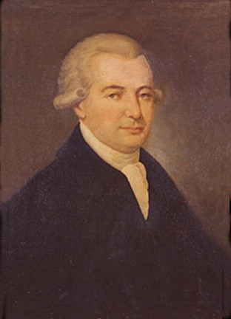
George Walton –
Walton County is named for him.
© 2014 Brain Wrinkles

Slide 29
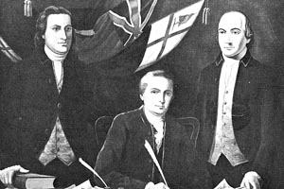
Georgia’s Delegates’
Signatures
© 2014 Brain Wrinkles

